Slide 1

BCO Portal and BCODB
Notes:
Change to 1.0

Slide 2
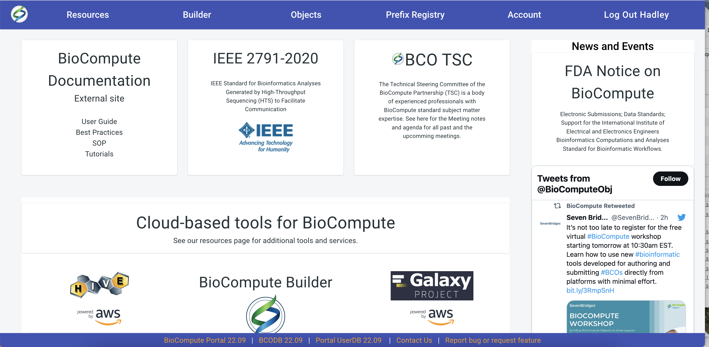
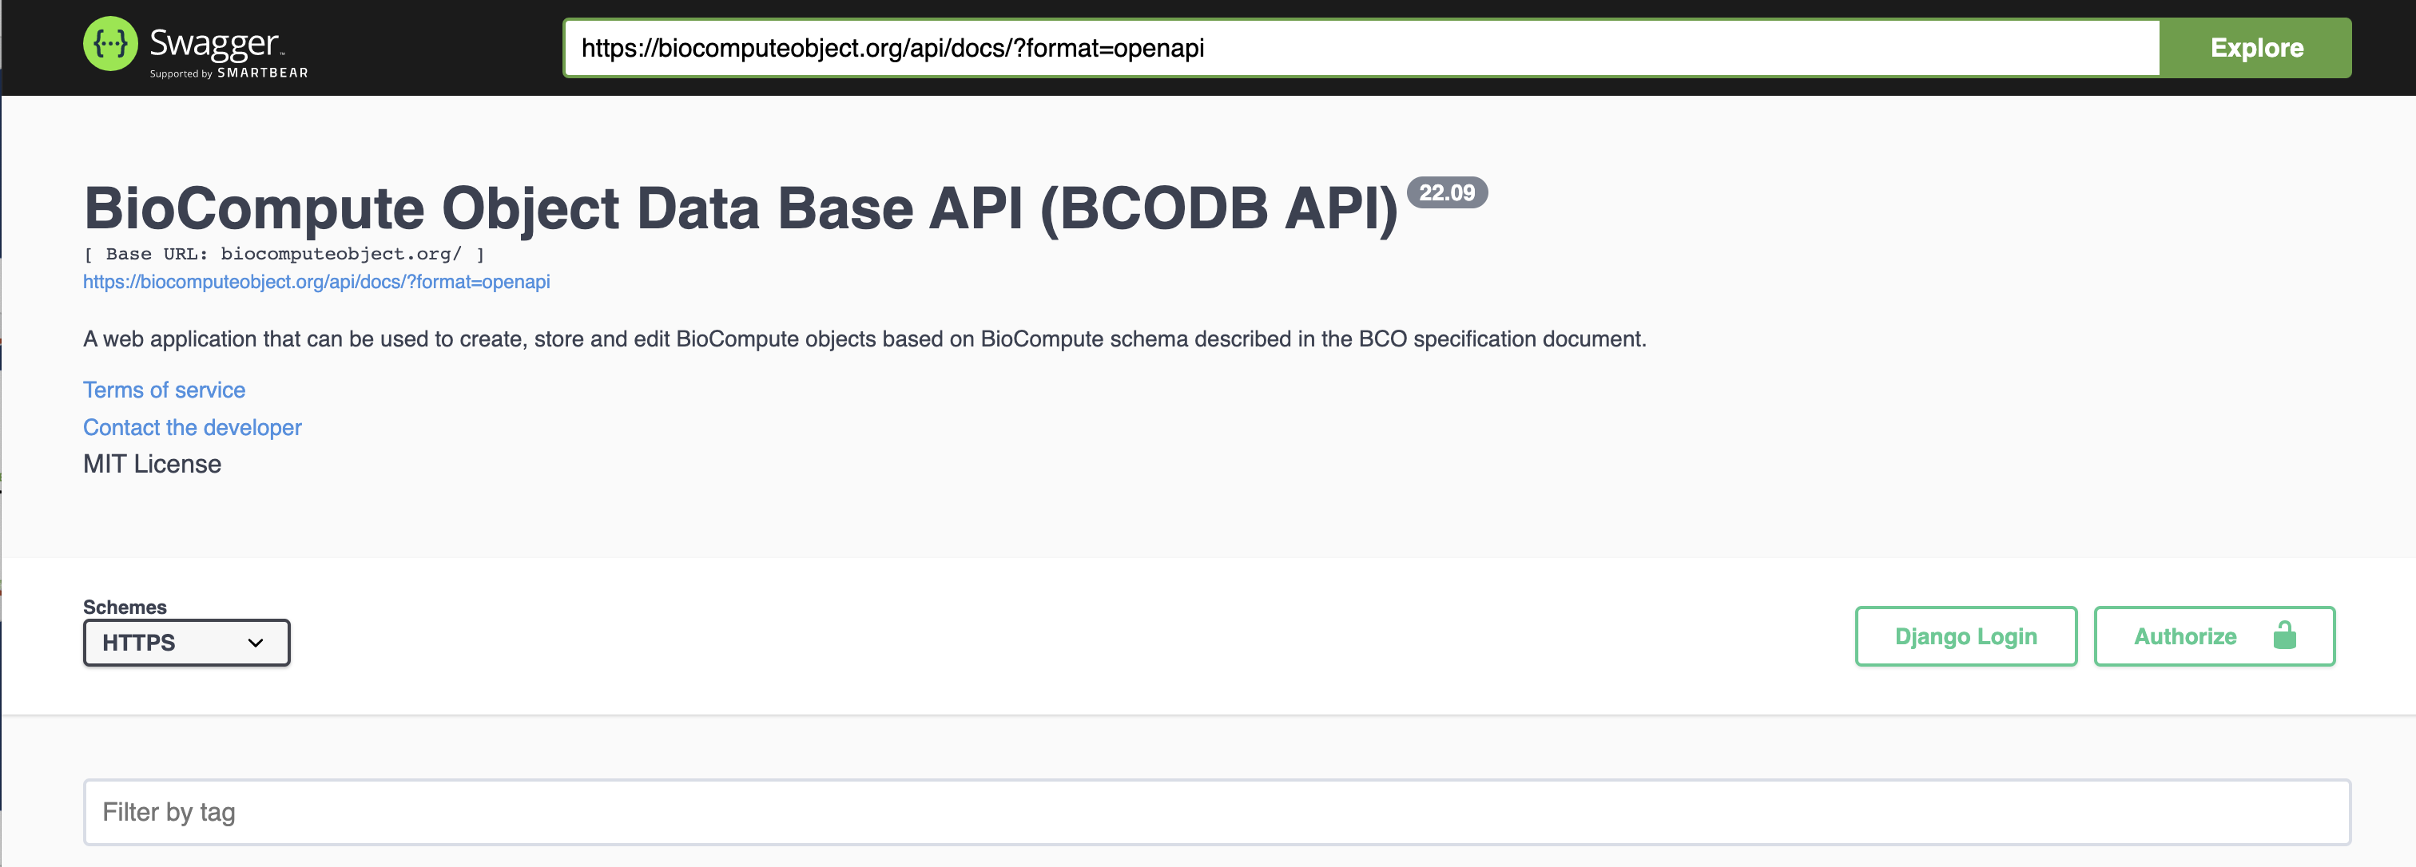
BCO Portal and BCODB
BCO PORTAL
Aggregate of BioCompute resources
Possible to have multiple instances of BCODB associated with one account
BCO DB
Independent of the BCO Portal
BCODB instance attached to the BCO Portal is available for the public
Code is available via GitHub and anyone can set up an independent instance
BCO Portal and BCODB

Slide 3


BCO Portal and BCODB
Open Source
All source code is available via GitHub
Contributions WELCOME!!
BCO PORTAL
JavaScript (React) front end
https://github.com/biocompute-objects/portal
BCO DB
Python (Django) with SQLite 3 database
https://github.com/biocompute-objects/bco_api
BCO DB
Python (Django) with SQLite 3 database
https://github.com/biocompute-objects/userdbi
BCO Portal and BCODB

Slide 4
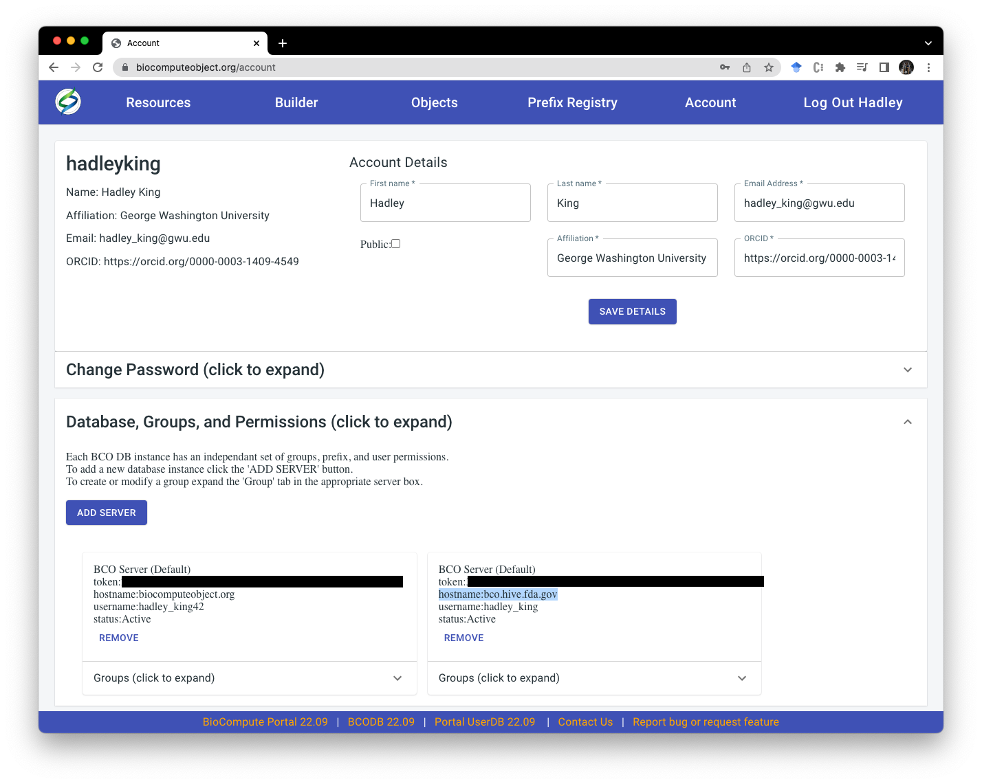
BCO Portal and BCODB
Server Information - Account Page
BCOs, prefixes, groups, and permissions are SERVER specific (BCODB instance)
BCO Portal users can have multiple “servers” associated with their account.
BCO Portal and BCODB

Slide 5
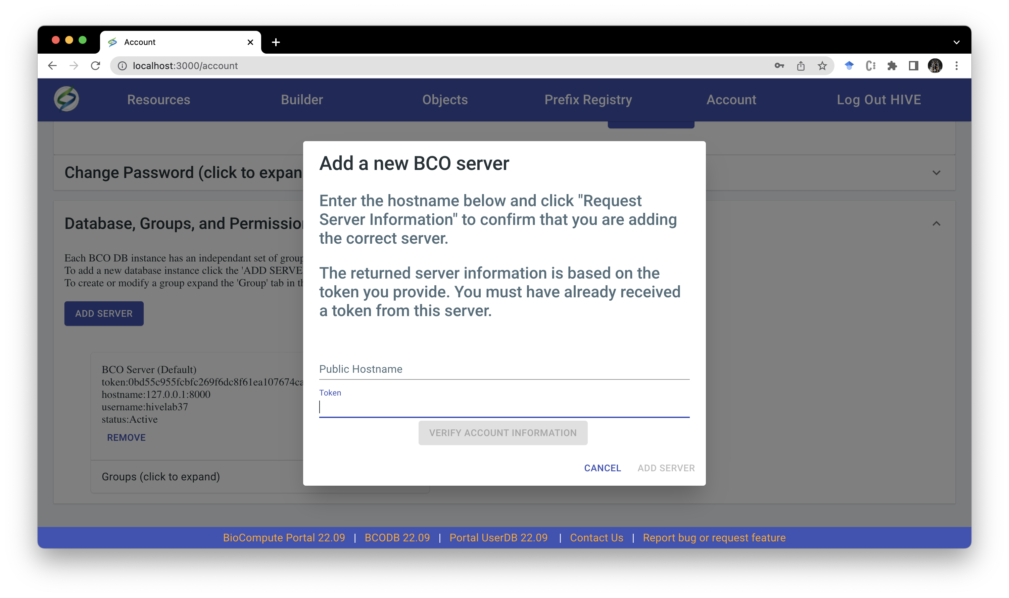
BCO Portal and BCODB
Adding a New Server (BCODB)
Requires a Token and the URL
“Verify Account Information” checks for access to provided URL via provided token
Once an additional server is added the user has access to that BCODB via BCO portal
BCO Portal and BCODB

Slide 6
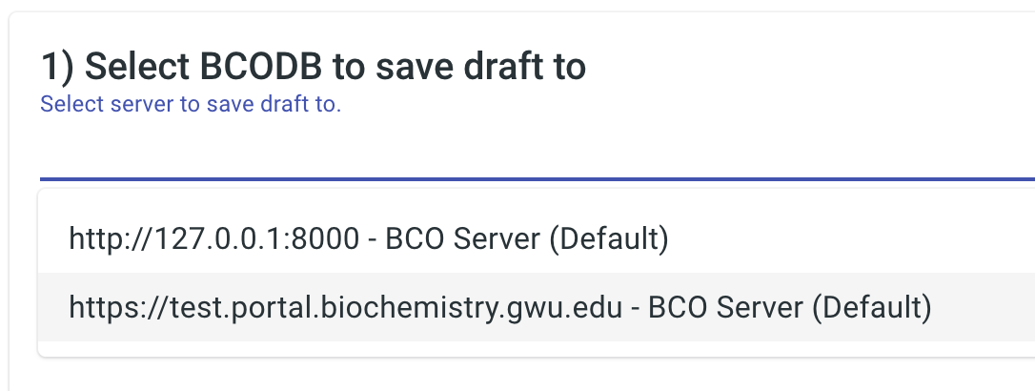
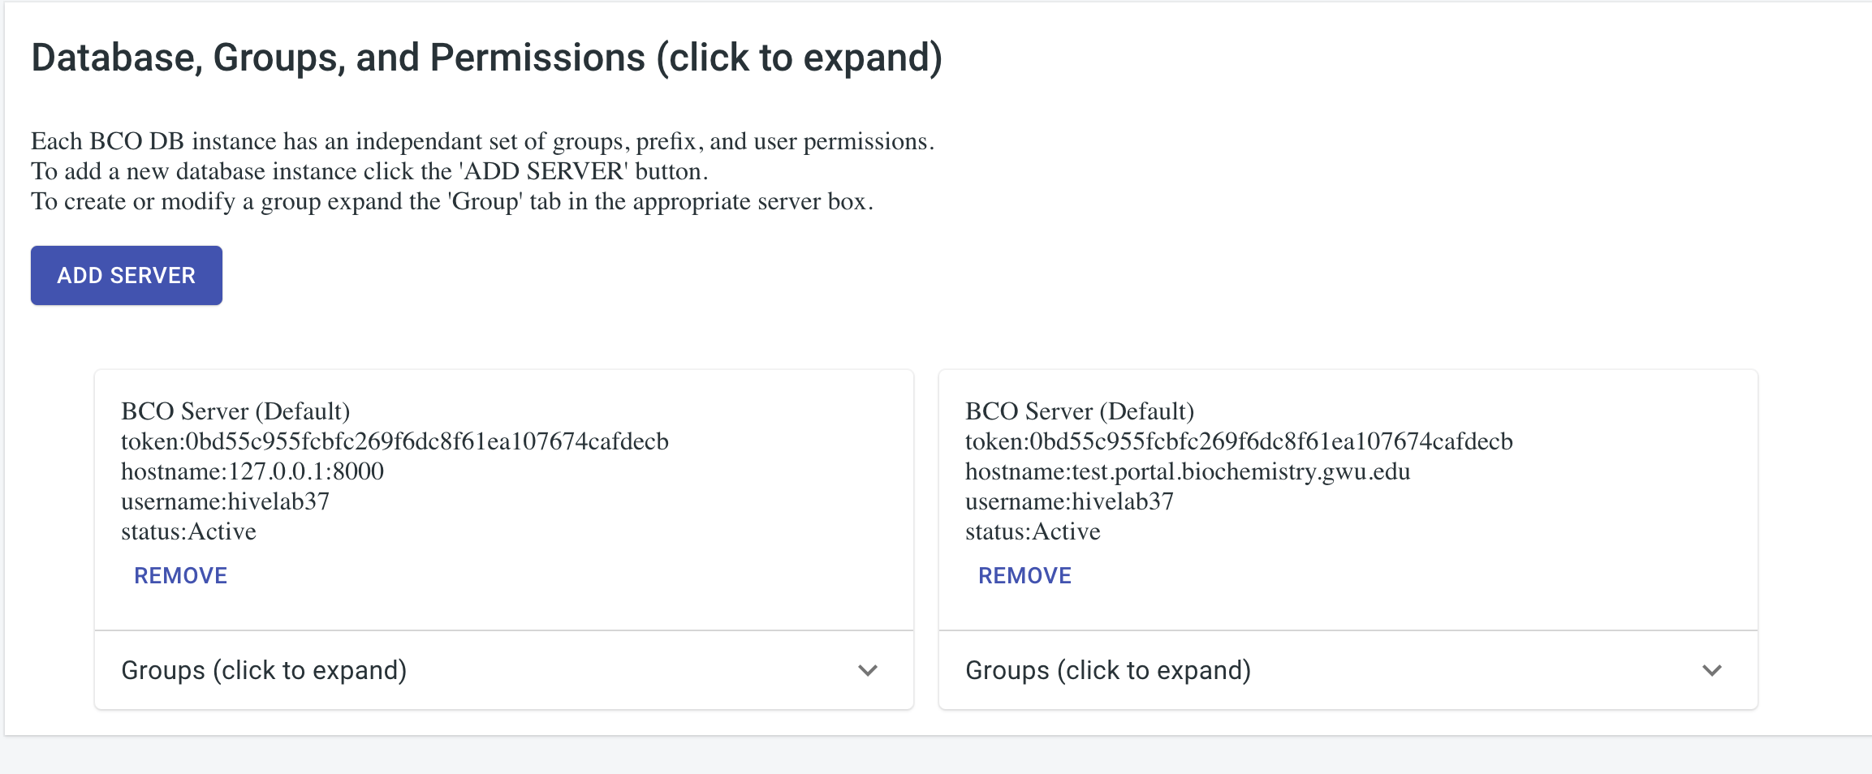
BCO Portal and BCODB
Adding a New Server (BCODB)
When creating a new draft object the user can select from all available BCODB instances
The user also has access to the groups function from the account page
BCO Portal and BCODB

Slide 7
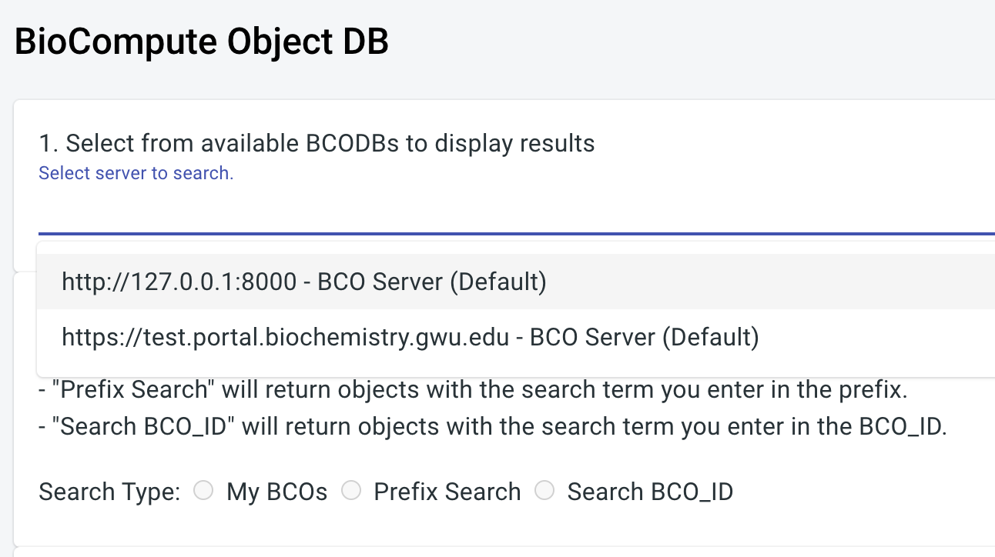
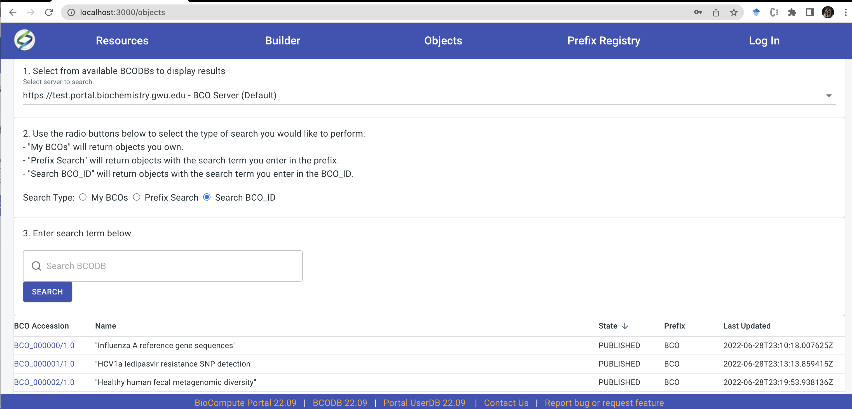
BCO Portal and BCODB
Adding a New Server (BCODB)
When searching for BCOs the user can select from all available BCODB instances
The user can search and brows BCOs for any instance they have access to
BCO Portal and BCODB

Slide 8
Prefix Registry

Slide 9
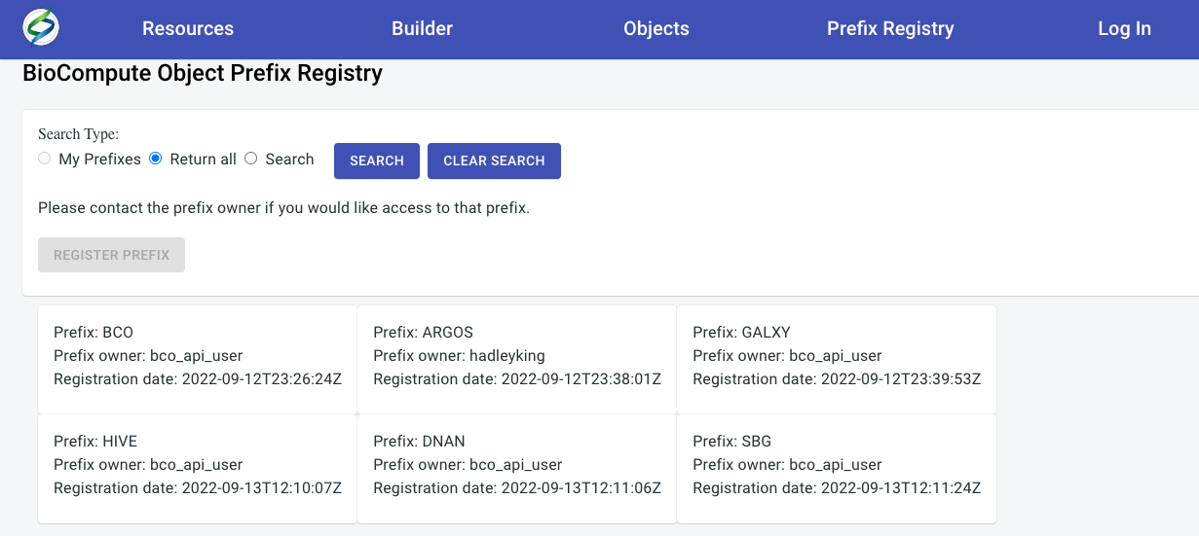
Prefix Registry
BCO Prefix Registry
https://biocomputeobject.org/prefix
No account required to browse
Any user can register a prefix (must be logged in)
Prefix Registry

Slide 10
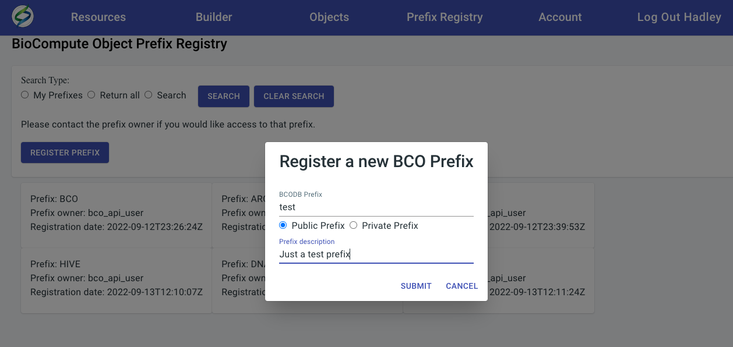
Prefix Registry
Create Prefix
Users logged in can register a prefix
Can choose public or private
Public prefixes are available to all other users to create DRAFTs and publish
Prefix Registry

Slide 11
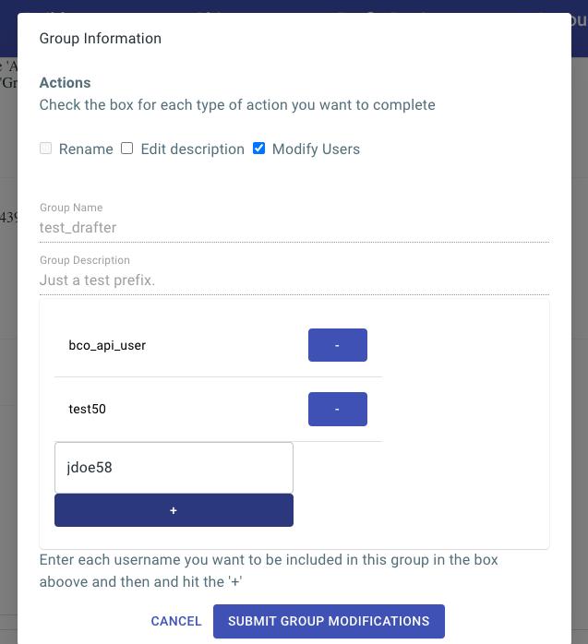
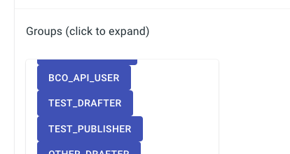
Prefix Registry
Prefix access control
Each PRIVATE prefix will spawn two user groups
<PREFIX>_DRAFTER and <PREFIX>_PUBLISHER
Prefix owner must add other users to the group
SERVER SPECIFIC
Must use BCODB username
Prefix Registry

Slide 12
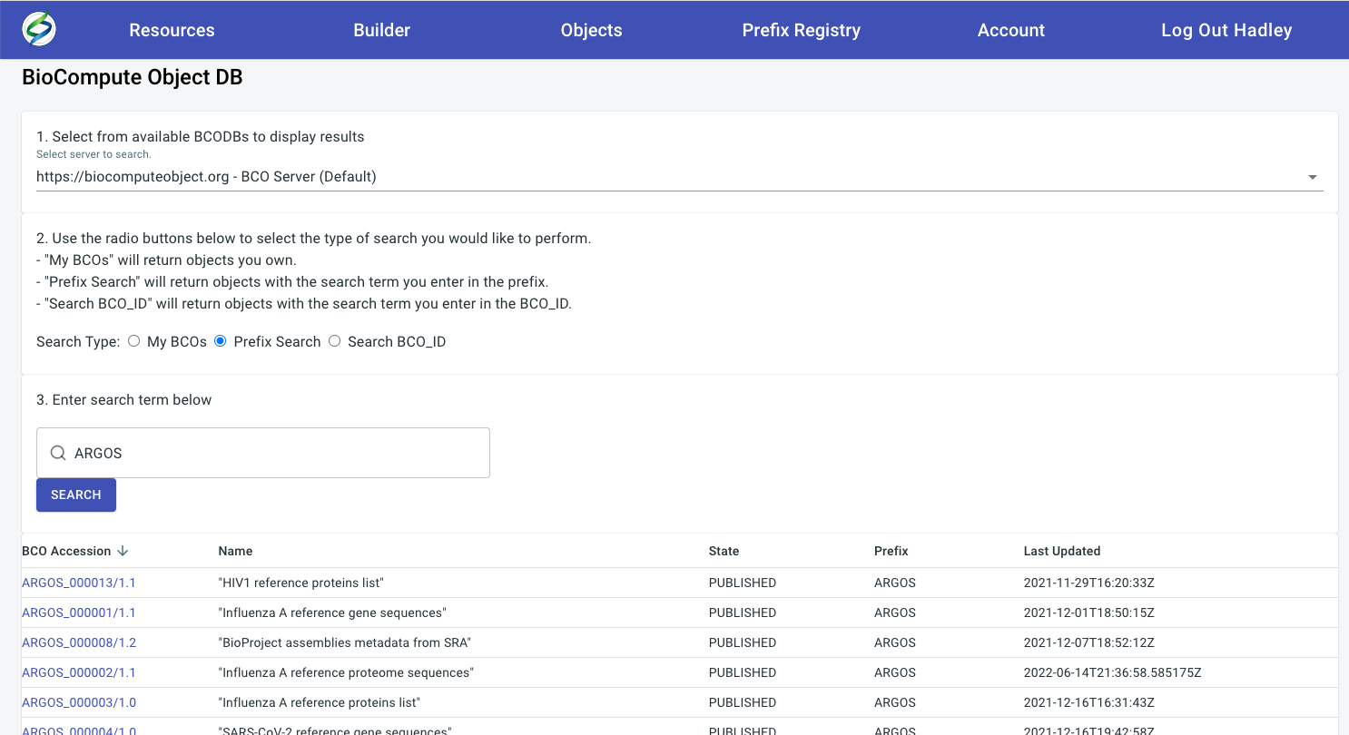
Prefix Registry
Searching for a prefix
SERVER specific
Can sort by:
state (DRAFT/PUBLISHED)
Accession
Name
Last updated (date)
Prefixes can organize BCOs into categories
Prefix Registry

Slide 13
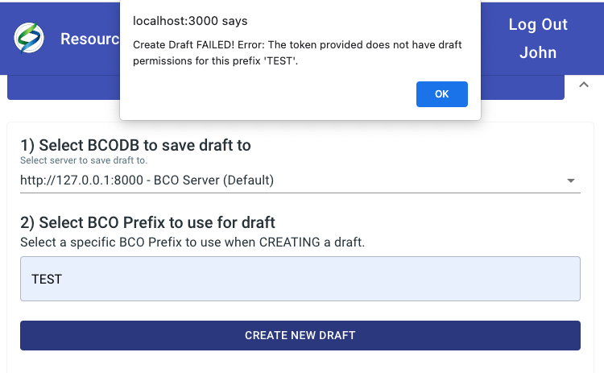
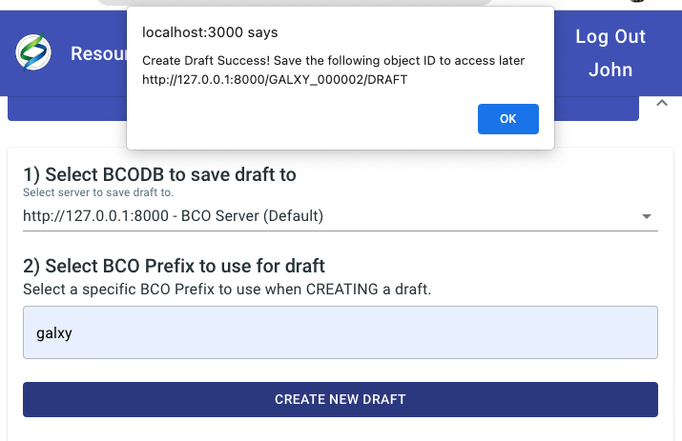
Prefix Registry
Creating a BCO with a prefix
Once server is selected users can enter a prefix
If they are in the <PREFIX>_DRAFTER group they will get a success message.
This functionality also applies to the <PREFIX>_PUBLISHER group.
Prefix Registry

Slide 14
BCODB API

Slide 15
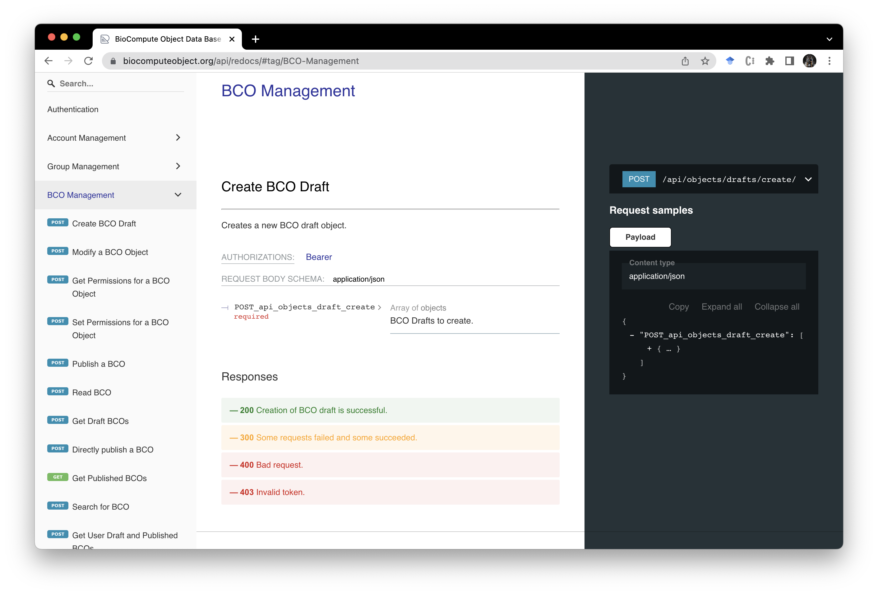
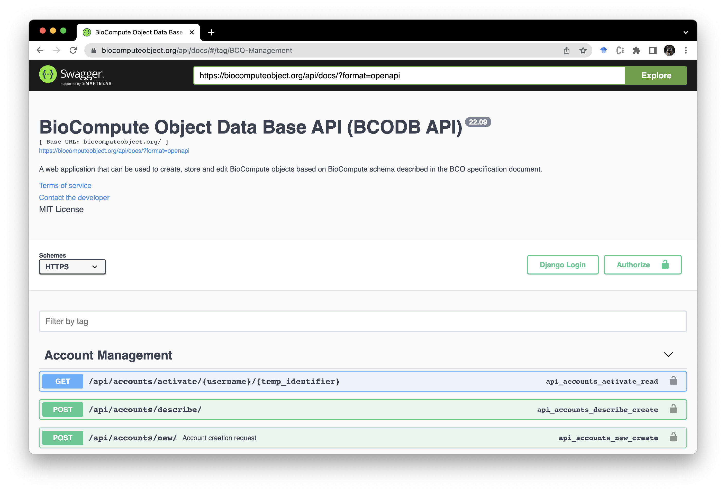
BCODB API
BCODB API docs
Two ways to view available API commands
Out-of-the-box availability
https://biocomputeobject.org/api/redocs/
https://biocomputeobject.org/api/docs/
BCODB API

Slide 16
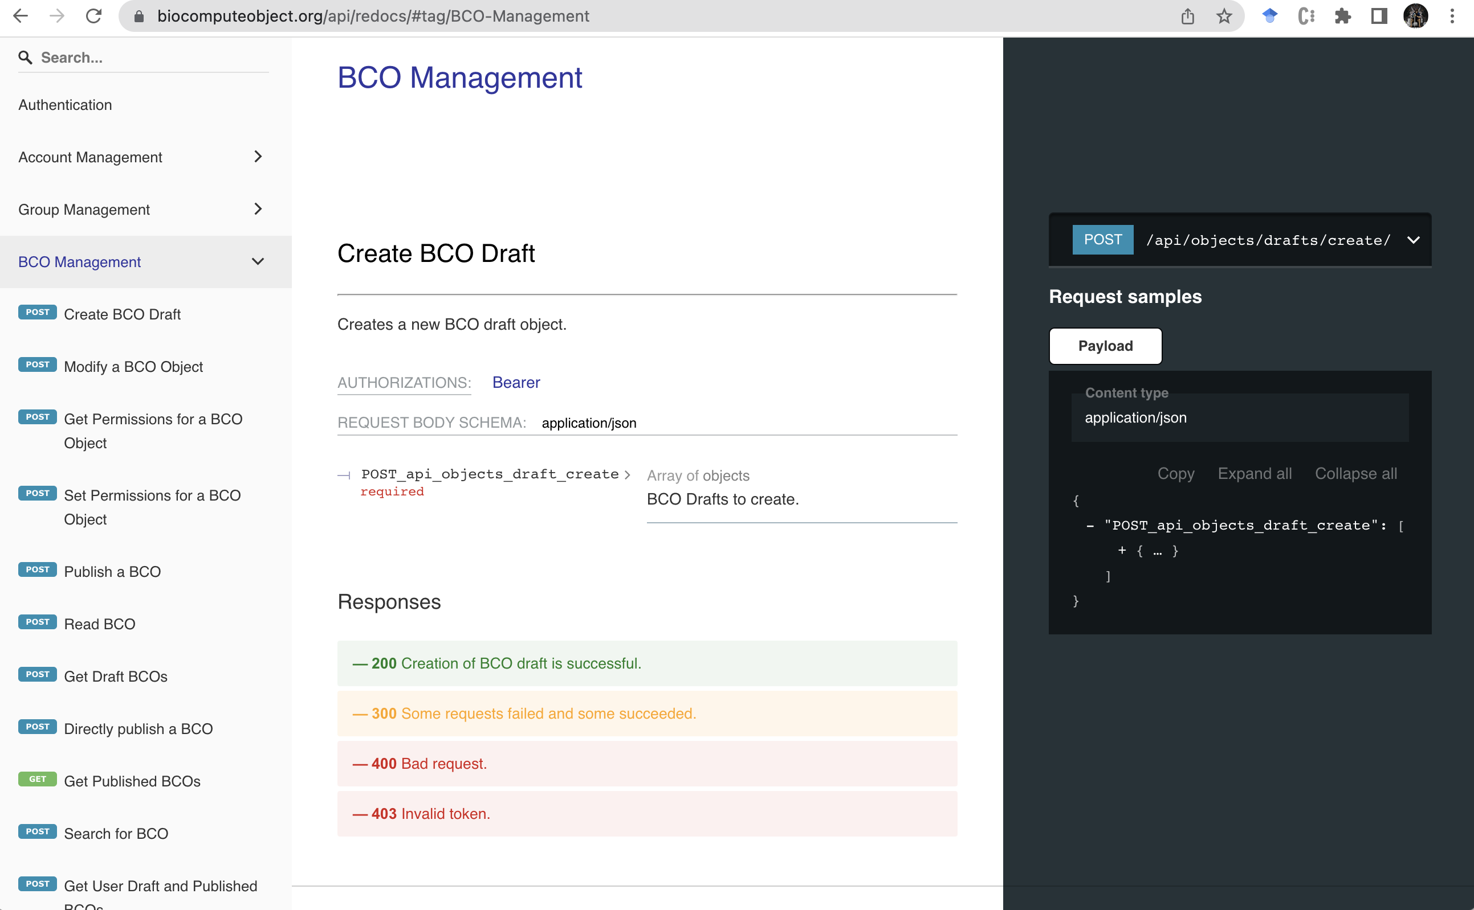
BCODB API
BCODB API ReDocs
Designed for readability
Standard layout for all API commands
Three panel layout makes navigation easy
BCODB API

Slide 17
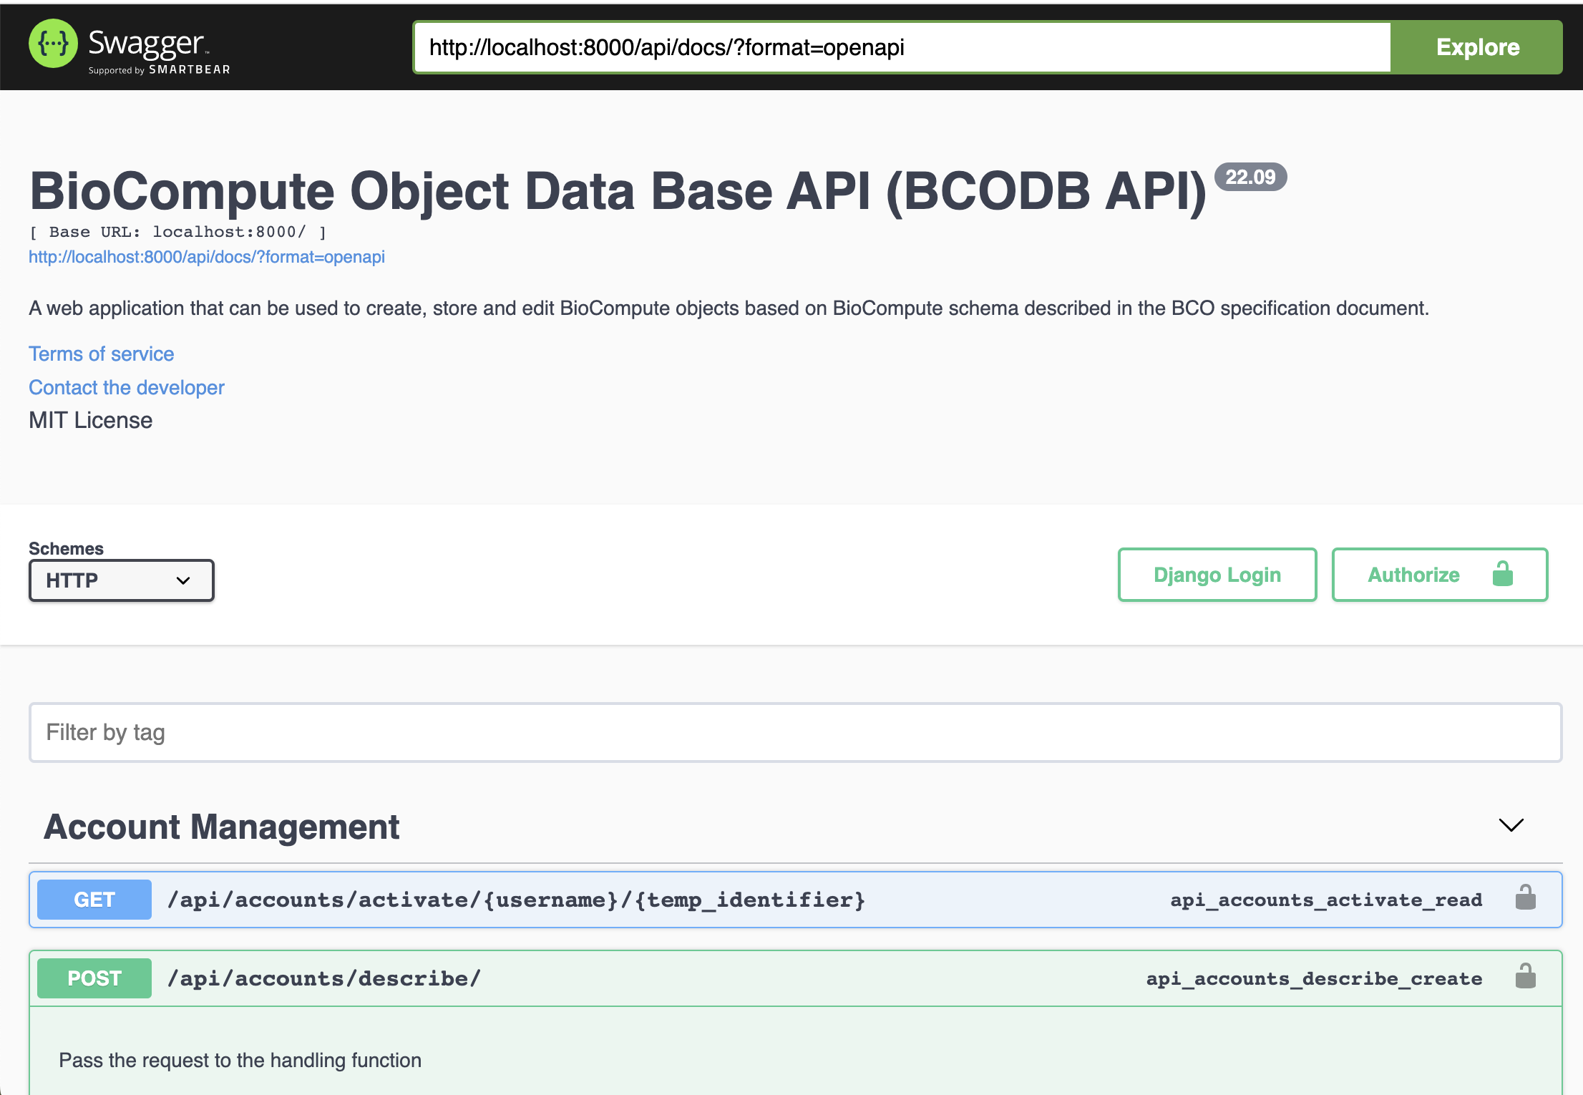
BCODB API
BCODB API Swagger Docs
Designed for usability
Standard layout for all API commands
Organized by collapsible endpoints
Can test out API functions in browser
BCODB API

Slide 18
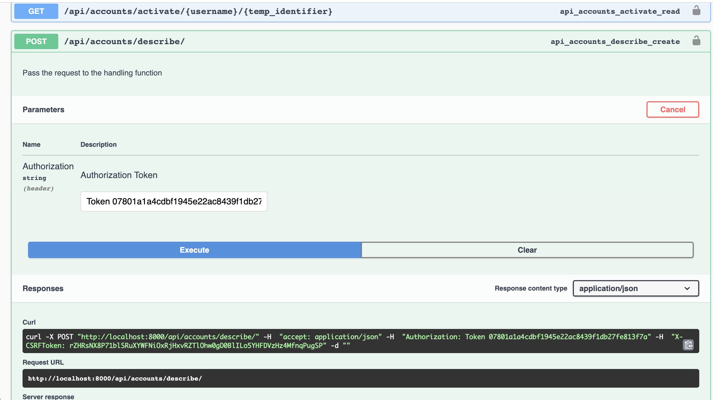
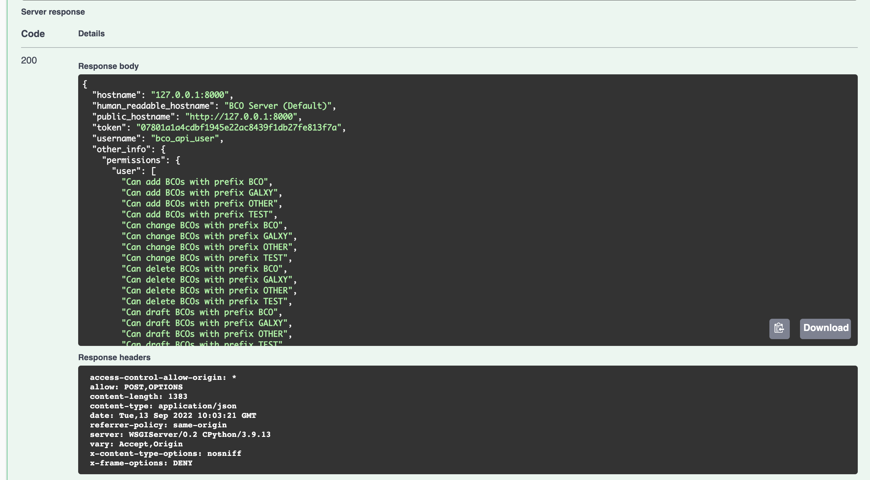
BCODB API
BCODB API Swagger Docs
Each function can be used in a browser
Easy authentication when required
FULL Request and full response displayed in browser
BCODB API

Slide 19
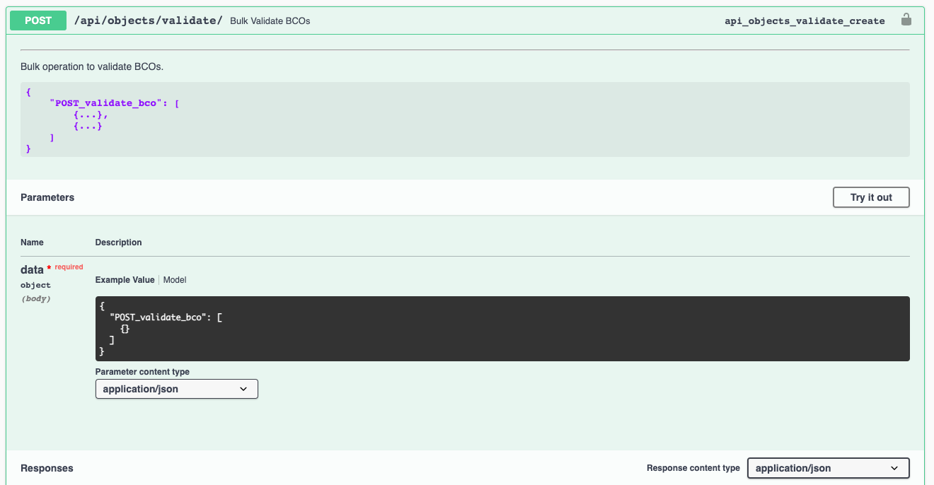
BCODB API
https://biocomputeobject.org/api/objects/validate/
OR
https://biocomputeobject.org/api/docs/#/BCO%20Management/api_objects_validate_create
Bulk BCO Validation
No authentication required
Can submit many BCOs at once
Results are returned for each BCO
BCODB API

Slide 20
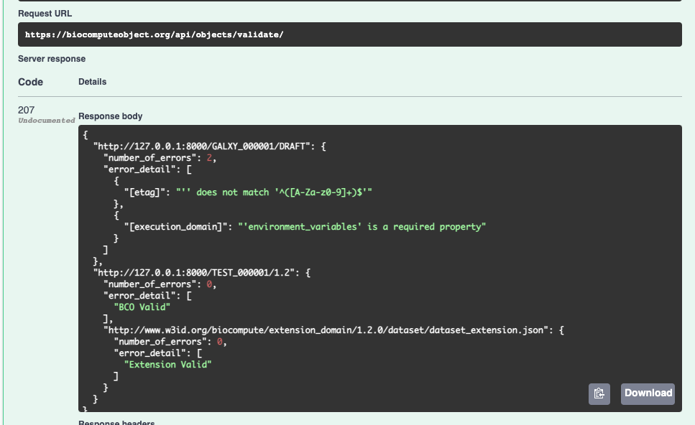
BCODB API
Bulk BCO Validation: Results
Response is a JSON object.
Results for each BCO returned based on object_id
Each error is listed separately
Also checks validity of extension_domain
BCODB API

